Slide 1
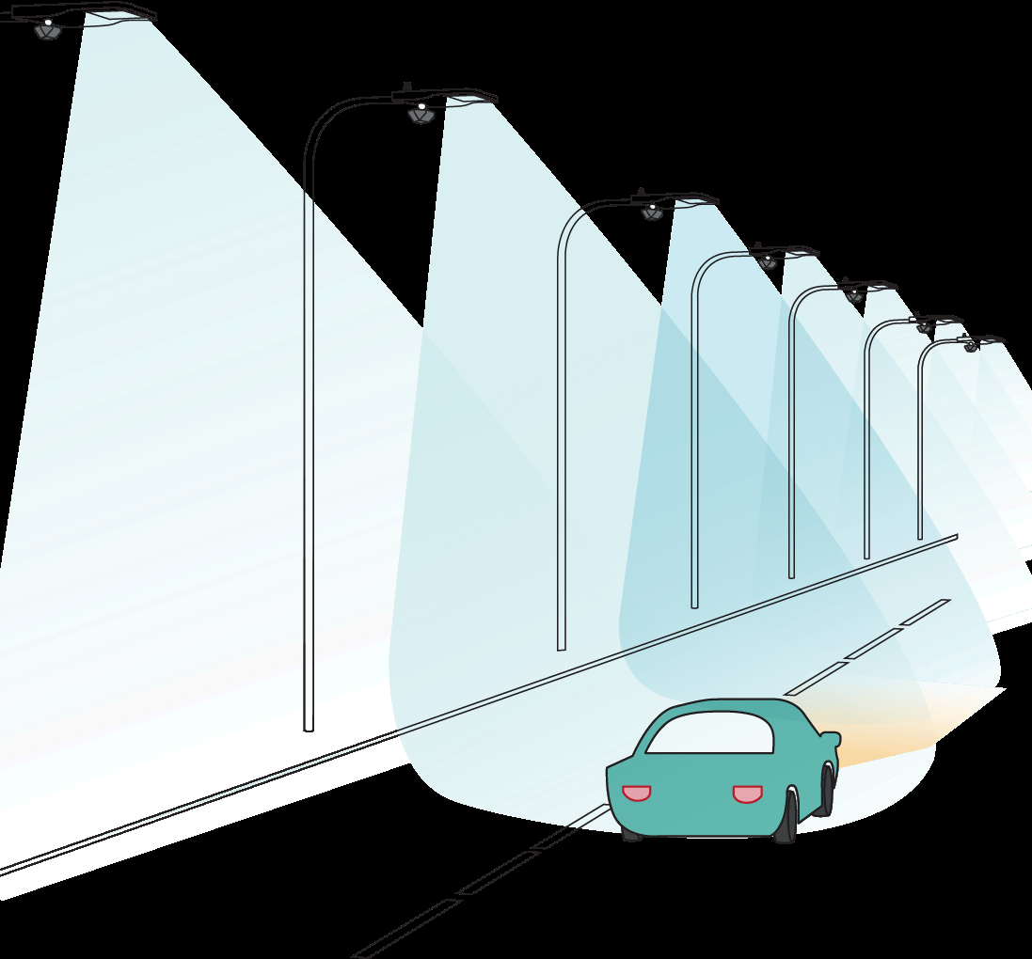
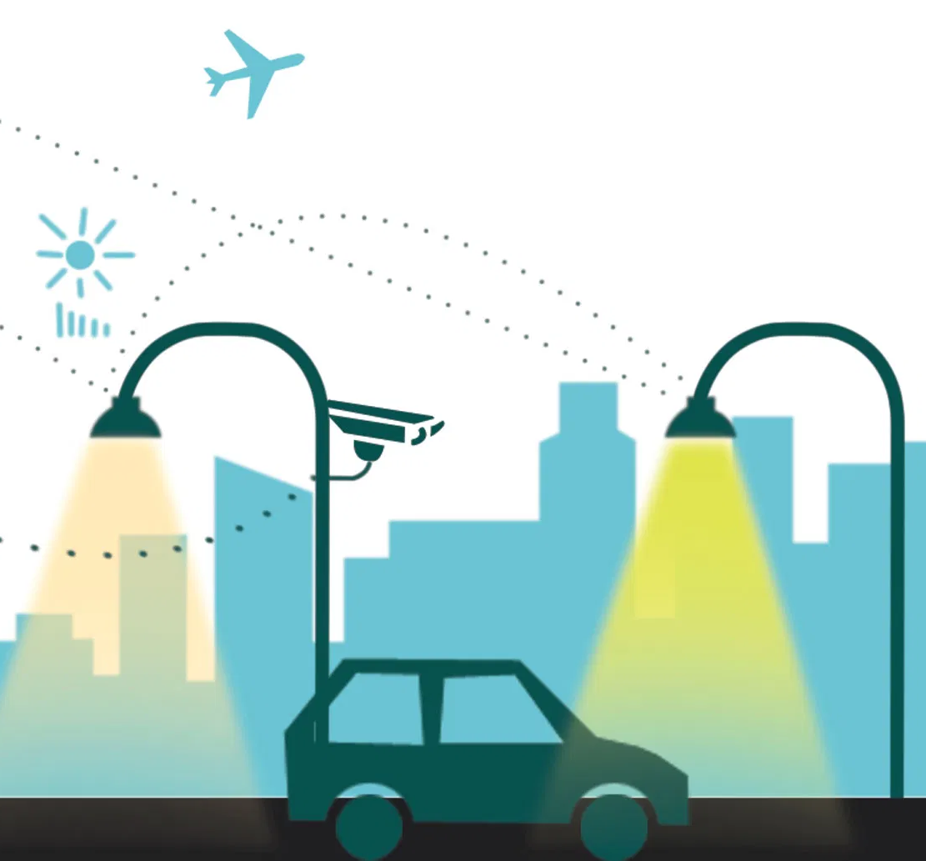
IOT BASED SMART STREET LIGHT
SMART LAMP FOR SAVING THE ELECTRICITY AND ENVIRONMENT

Slide 2
IOT based smart Street Lights project exhibhition group members-
Bhushan Mahajan – 19MIM10074
Shashwat Jha – 19MIM10111
Himanshu Farkya – 19MIM10085
Mayank Samadhiya – 19MIM10077
Project Director :
Dr. Sampath Kumar

Slide 3
INTRODUCTION
We, Students of Integrated M.Tech Have Designed a Project on IOT Based Smart Streetlights.
We Used the Hardware Component Like IR Sensors ,LED, Wi-Fi Module ,Arduino, LDR.
We Completed the Project in the Time span of 40 Days.
We Took References from Various Articles, Blogs, Videos and Books.
The aim of automated streetlight management system using IOT is the conservation of energy by reducing electricity wastage as well as to reduce the manpower and Easier Controlling.

Slide 4
EXISTING WORK WITH LIMITATIONS:
More than 27 million street lights light up the nights in india .
It consumed as 20% to 40% of total energy consumption .
It may be considered as a major component in electricity consumption .
During day time due to some fault SOME STREELIGHTS REMAIN ON AND DUE TO THIS HUGE AMOUNT OF ELECTRICITY IS WASTED.
IT IS SOMETIMES DIFFICULT FOR REPARING A PARTICULAR STREET LAMP BECAUSE SOMETIMES IT IS NOT TRACKABLE EASILY.

Slide 5
EXISTING WORK
India is the world's 3rd largest consumers of electricity.
India has an installed capacity of 371,977 GW as of 31st July 2020.

Slide 6
EXISTING WORK WITH LIMITATIONS
The key problems:
Currently, street lighting in India faces many problems. Some of these are:
Faulty lights
Firstly, there is no baseline data to understand how many faulty lights are in the field. Next issue is that there is no data to understand which make of lights work or which don’t and their lifetime. There is a good chance that a particular manufacturer is not suitable for India, or that while a particular brand is cheap to acquire, they have a high failure rate.
Electricity theft
Electricity theft is a huge problem in India. There is no data on the amount of electricity consumed by each light, or on a broader level, even how much a phase consumes; thus, there is no way of determining if there is a leak somewhere in the line.
Unnecessary usage
Despite being an electricity deficient country, it is common to see street lights working even during the day. This leads to wastage of electricity. In order to understand how much energy is wasted, and how it can be stopped, analytics is needed, yet again.

Slide 7
PROPOSED WORK
We Took This Project To Implement the Artificial Technology Using Internet of Thing (IoT) with Streetlight To Make them "Smart Streetlights".
Through This Project, We Could Achieve:-
We Could Get Alerts Related To Any Damage or Fault Of Each Particular Streetlight through The Application to the Servers like Some Lights Remained ON in Daytime, or Bulb Issue. Thus It Help Us In Getting Each And Every Live Update.
Keeping A track On Electricity Consumption Of Every Particular Streetlight And Thus Would Be Help In Optimizing Electricity Bills.
Resolving Any Technical Issue like Sorting the Faulty Streetlight would be easier Through The Application.Thus It Would Be Very Effective in Saving Electricity & Manpower ,Faster Resolution and Reducing Time.
We Could Also Integrate It With CCTV, Traffic Lights For A Perfect Survelliance Of The Traffic By Server Rooms.

Slide 8
METHODOLOGY
The working of the project can be clearly explained by considering the Street Lights.
The main of the project is to automatic switch ON/OFF the Street Light by Sensing the Vehicles.
In this project IR's are used for Sensing the Vehicles.
Initially the street lights are in OFF state by using the LDR's.
As the IR senses the Vehicles the Street Lights associated with that sensor will switch ON and OFF after certain time.

Slide 9
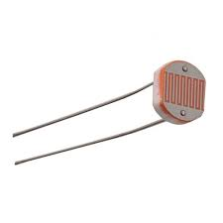
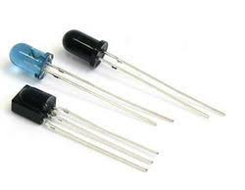
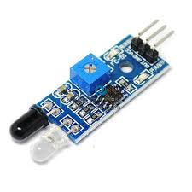
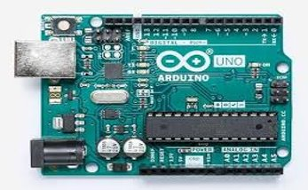
Equipments and working
1.Ldr (light dependent resistor)
photoresistor works on the principle of photoconductivity.
it is connected to aurduino.
2.Ir sensor (infra red sensor)
instrument that is used to sense certain characteristics of its surroundings by either emitting and/or detecting infrared radiation. It is also capable of measuring heat of an object.
3.LED (light emiting diode)
Light emitting diodes represents our lighting system and the amount of light emitted by it is directly related to the amount of light in the environment.
4.ARDUINO
Arduino consists of both a physical programmable circuit board and a piece of software, or IDE (Integrated Development Environment) that runs on your computer, used to write and upload computer code to the physical board.

Slide 10
NOVELTY OF OUR PROJECT:
Automatic switching of street lights
Maintenance cost reduction
Reduces electricity wastage.
Wireless communication
Energy saving
Reduction of manpower
Reduce energy consumption by up to 50%
Controlling of street lights made much more easier

Slide 11
REAL TIME USAGE
Lamps with led for consuming small amount of energy .
Increase or decrease the intensity of light according to darkness .
Give a special alert while faultage .
with every particular lamp to save the wasted energy .
Lamps with lower thermal energy consumption .
MANY LIGHTS CAN BE HANDLED USING SINGLE COMMAND
NO LIGHTS WOULD BE REMAINED ON DUE TO ERROR,IF SO THEN WILL BE ALERTED ACCORDINGLY.

Slide 12
SOFTWARE AND HARDWARE REQUIREMENTS
SOFTWARE
HARDWARE
ARDUINO IDE (COMPILER)
WIFI MODULE (ESP8266)
ARDUINO.CC LANGUAGE
ARDUINO UNO
MICROCONTROLLER
WI-FI MODULE (ESP8266)
IR SENSORS
LDR (LIGHT DETECTING REGISTER)
LED'S (LIGHT EMMITING DIODE)
REGISTERS
JUMPER WIRES
PCB AND BREADBOARD
CABLE AND CONNECTORS

Slide 13
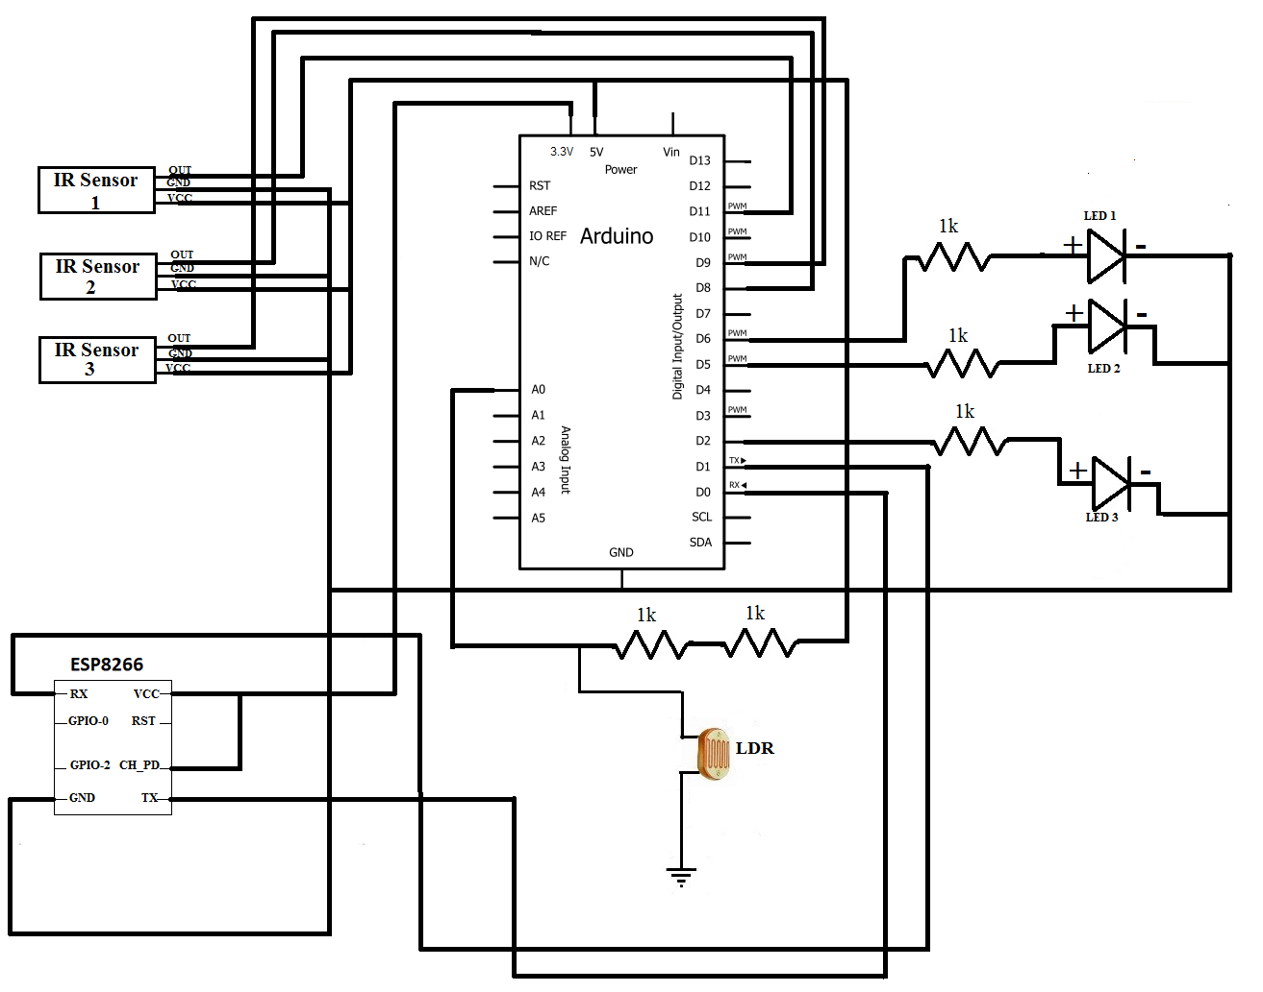
OVERALL SYSTEM AND ARCHITECTURE DIAGRAM

Slide 14
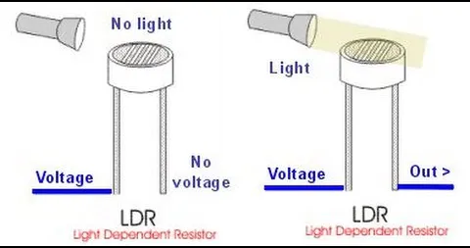
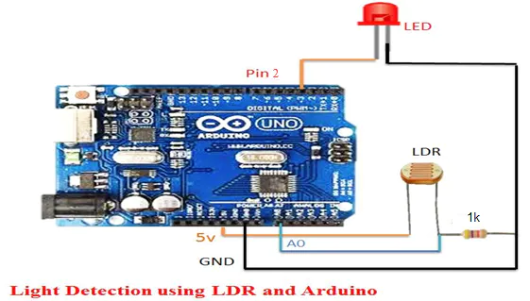
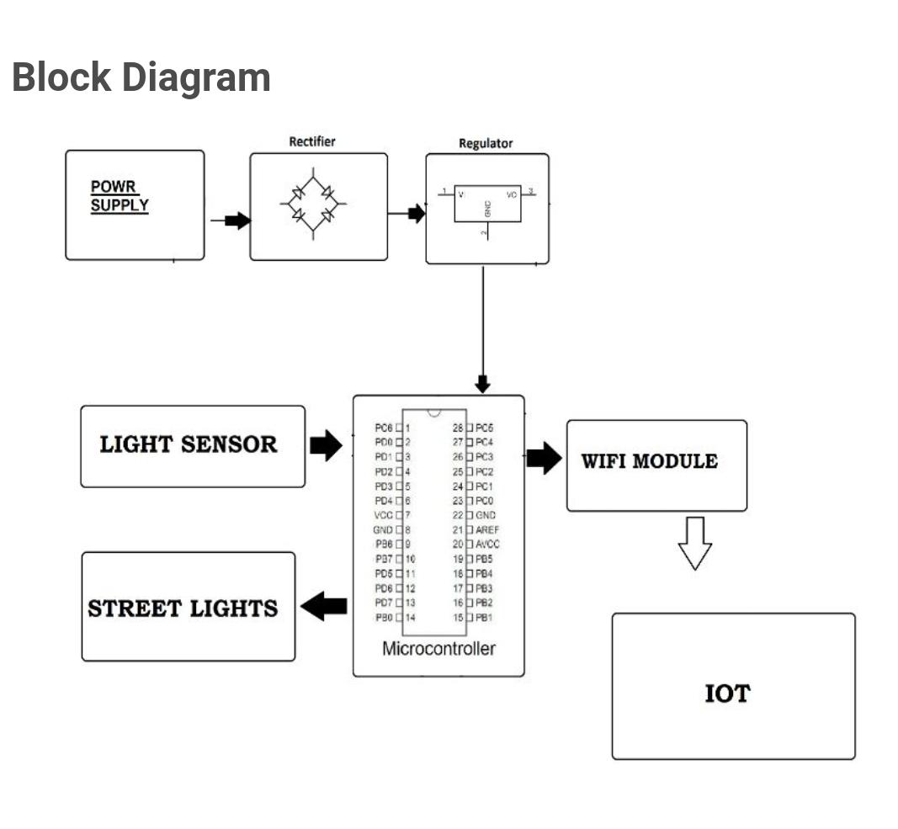
CIRCUIT DIAGRAM

Slide 15
LITERATURE REVIEW Reference From :- International Research Journal of Engineering and Technology (IRJET) IOT BASED DYNAMIC CONTROL OF STREET LIGHTS FOR SMART CITY
Snehal Bhosale ,Komal Gaware ,Pradnya Phalke ,Dipali Wadekar, Pallavi Ahire
Student, Dept. of Information Technology, Sinhgad Institute of Technology, Lonavala, Maharashtra, India
1.ESP 8266 wireless module is used for street light controlling
Their aim is to monitor the vitality of street lights and forward monitored returns to the control station. Inside the lamp module, it consists of light dependent resistors (LDR) module, microcontroller module and the transmission module.
2. Optimisation of a standalone street light system with consideration of lighting control.
This paper aims at designing and executing the advanced development of embedded systems for energy saving of street lamps. Nowadays, the human has become too busy and is unable to find time even to switch the lights wherever not necessary. This paper gives the best solution for electrical power wastage.

Slide 16

MODULE DESCRIPTION:
esp8266 (wi-fi module chip)
It is mostly used for development of IoT (Internet of Things) embedded applications.
ESP8266 comes with capabilities of
2.4 GHz Wi-Fi (802.11 b/g/n, supporting WPA/WPA2)
General purpose input/output (16 GPIO)
Inter-integrated circuit (I²C) serial communication protocol
Analog-to-digital conversion (10-bit ADC)
Serial peripheral interface (SPI) serial communication protocol
I²S (inter-IC sound) interfaces with DMA (direct memory access) (sharing pins with GPIO)
UART (on dedicated pins, plus a transmit-only UART can be enabled on GPIO2)
Pulse-width modulation (PWM)

Slide 17

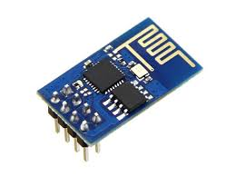
MODULE EXPLANATION: ESP8266 (WiFi - Module chip)
High Durability
ESP8266EX is capable of functioning consistently in industrial environments, due to its wide operating temperature range. With highly-integrated on-chip features and minimal external discrete component count, the chip offers reliability, compactness and robustness.
Compactness
ESP8266EX is integrated with a 32-bit Tensilica processor, standard digital peripheral interfaces, antenna switches, RF balun, power amplifier, low noise receive amplifier, filters and power management modules. All of them are included in one small package, our ESP8266EX.

Slide 18


MODULE EXPLANATION: ESP8266 (wi-fi module chip)
Power-Saving Architecture
Engineered for mobile devices, wearable electronics and IoT applications, ESP8266EX achieves low power consumption with a combination of several proprietary technologies. The power-saving architecture features three modes of operation: active mode, sleep mode and deep sleep mode. This allows battery-powered designs to run longer.
32-bit Tensilica Processor
The ESP8266EX microcontroller integrates a Tensilica L106 32-bit RISC processor, which achieves extra-low power consumption and reaches a maximum clock speed of 160 MHz. The Real-Time Operating System (RTOS) and Wi-Fi stack allow about 80% of the processing power to be available for user application programming and development.

Slide 19
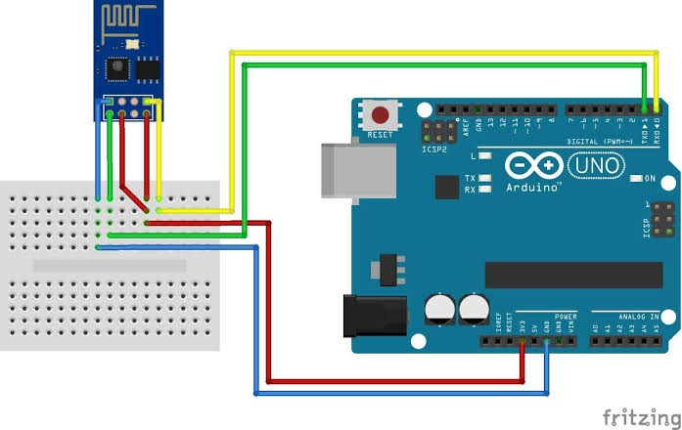
INTEGRATION OF WI-FI MODULE WITH AURDINO IDE

Slide 20
CODING PART
Variables declaration
int led = 2;​
int led1 = 3;​
int led2 = 4;​
int led3 = 5;​
int led4 = 6;​
​
int ldr = A5;​
int ir = A0;​
int ir1 = A1;​
int ir2 = A2;​
int ir3 = A3;​
int ir4 = A4;​

Slide 21
CODING PART
SETUP PART
void setup() ​
{​
Serial.begin (9600);​
pinMode (led,OUTPUT);​
pinMode (led1,OUTPUT);​
pinMode (led2,OUTPUT);​
pinMode (led3,OUTPUT);​
pinMode (led4,OUTPUT);​
pinMode (ldr,INPUT);​
pinMode (ir,INPUT);​
pinMode (ir1,INPUT);​
pinMode (ir2,INPUT);​
pinMode (ir3,INPUT);​
​
pinMode (ir4,INPUT);​

Slide 22
CODING PART
LOOPING PART
(Conditions That We Applied)
void loop() ​
{​
Serial.println(analogRead(A5));​
int ldrStatus = analogRead (ldr);​
if (ldrStatus <=500)​
{​
​
digitalWrite(led, HIGH);​
analogWrite(led,255/5);​
​
digitalWrite(led1, HIGH);​
analogWrite(led1,255/5);​
​
digitalWrite(led2, HIGH);​
analogWrite(led2,255/5); ​
​
digitalWrite(led2, HIGH);​
analogWrite(led2,255/5); ​
​

Slide 23
CODING PART
LOOPING PART
(Conditions That We Applied on our IR Sensors)
if​
(analogRead(A1)<300) // IR 1 CODE ​
{​
digitalWrite(led1,HIGH);​
analogWrite(led1,255); ​
delay(1000);// micro second​
} ​
else ​
{​
digitalWrite(led1,HIGH);​
analogWrite(led1,255/5);​
} ​

Slide 24
CODING PART
LOOPING PART
(Conditions That We Applied on our IR Sensors)
if (analogRead(A2)<300) // IR 2 CODE​
{​
digitalWrite(led2,HIGH);​
analogWrite(led2,255); ​
delay(1000);// micro second​
} ​
else ​
{​
digitalWrite(led2,HIGH);​
analogWrite(led2,255/5); ​
​
}

Slide 25
CODING PART
LOOPING PART
(Conditions That We Applied on our IR Sensors)
if (analogRead(A3)<300) // IR 2 CODE​
{​
digitalWrite(led3,HIGH);​
analogWrite(led3,255); ​
delay(1000);// micro second​
} ​
else ​
{​
digitalWrite(led3,HIGH);​
analogWrite(led3,255/5); ​

Slide 26
CODING PART
LOOPING PART
(Conditions That We Applied on our IR Sensors)
if (analogRead(A4)<300) // IR 2 CODE​
{​
digitalWrite(led4,HIGH);​
analogWrite(led4,255); ​
delay(1000);// micro second​
} ​
else ​
{​
digitalWrite(led4,HIGH);​
analogWrite(led4,255/5); ​
​
}​
}​

Slide 27
CODING PART
LOOPING PART
(Conditions That We Applied on our IR Sensors)
else ​
{​
​
digitalWrite(led1, LOW);​
digitalWrite(led2, LOW);​
digitalWrite(led3, LOW);​
digitalWrite(led4, LOW);​
​
}​
​
}

Slide 28

DEMO VIDEO

Slide 29
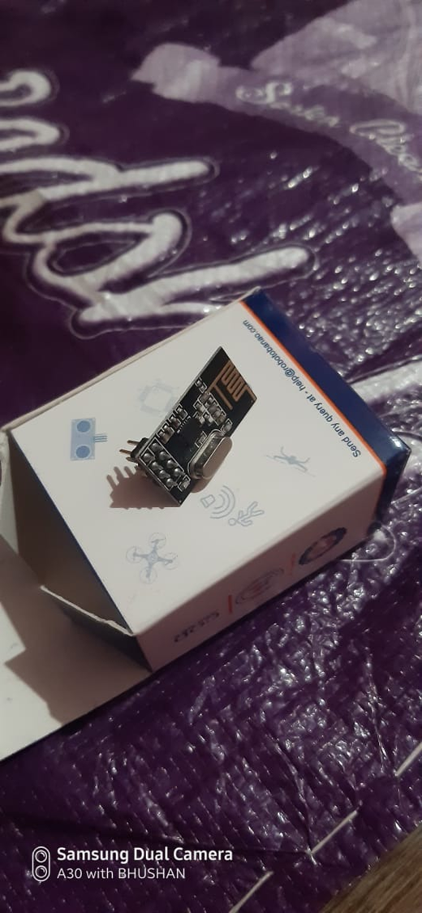
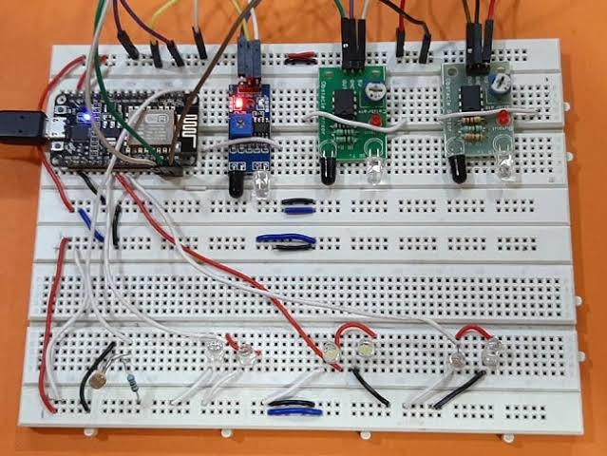

SNAP SHOT OF OUR WIFI MODULE AND ITS IMPLEMENTATION:

Slide 30

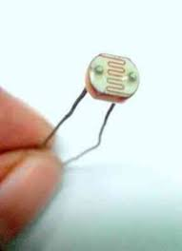
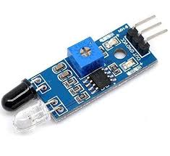
SNAP SHOT OF HARDWARE COMPONENTS

Slide 31
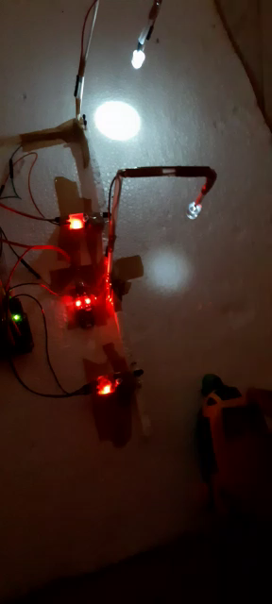
TESTING VIDEO

Slide 32
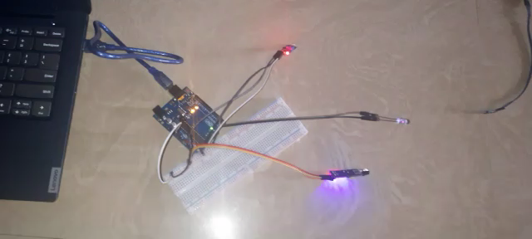
DEMO VIDEO

Slide 33
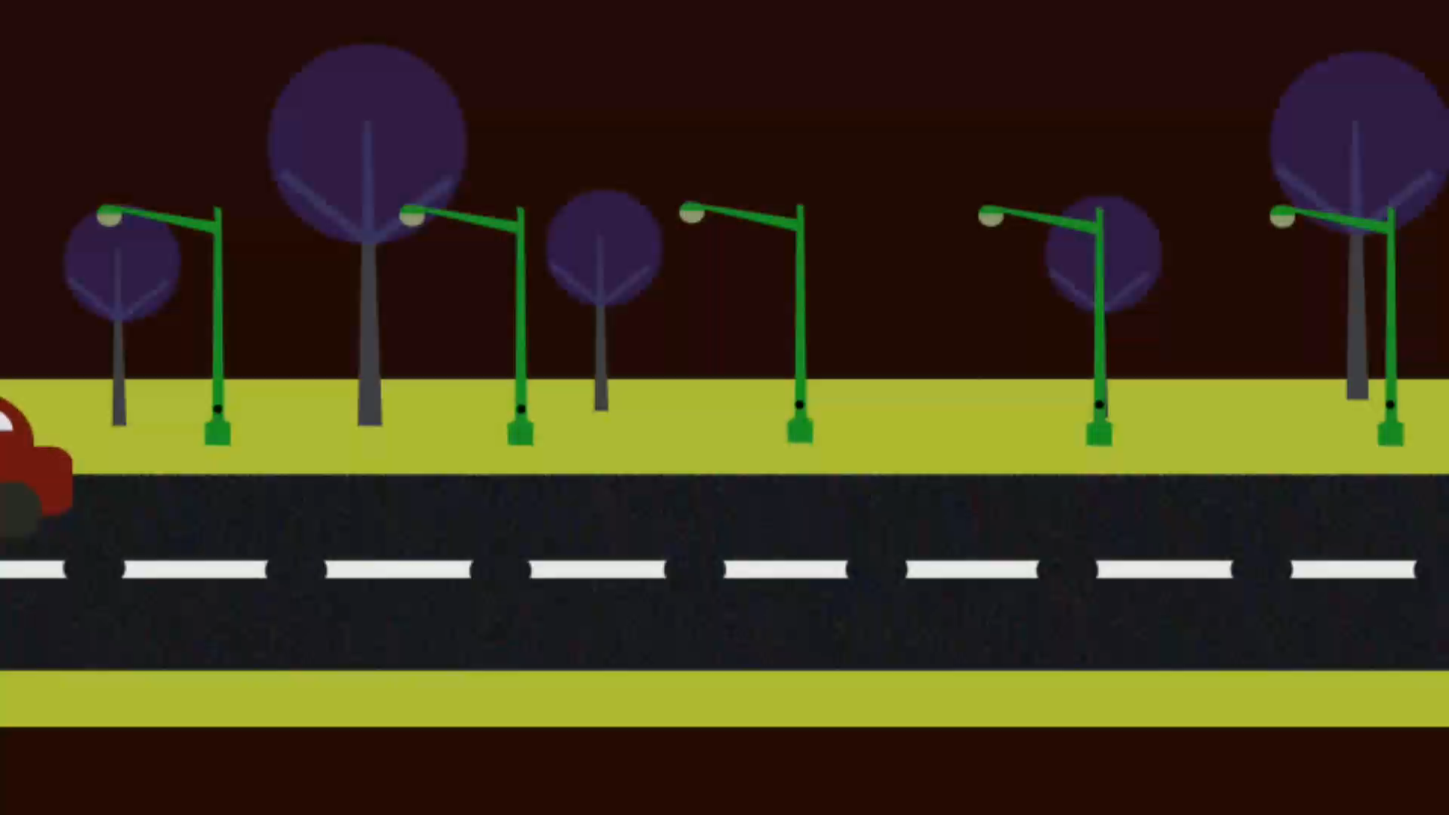
ILLUSTRATION THROUGH AN ANIMATION

Slide 34
CODING PART
CODE FOR WI-FI SERVERS IS STILL ON WORKING

Slide 35
RESULT
SERIAL NUMBER | VEHICLE NAME | SINGLE WAY TIME TAKEN (IN SECOND)
1 | AUTO | 3 SECOND
2 | JEEP | 4 SECOND

Slide 36
DISCUSSION
The working model of the smart street light system has successfully avoided the wastage of electricity. When it is dark and detects vehicle and people in the street, light would be switched on with full brightness. Otherwise , even if it is dark and nobody is detection streetlight would be switched on with less brightness. This saves power energy to larger extent.

Slide 37
CONCLUSION
The Important Aim of using IOT Based Smart Street Light we can save upto 50% of electricity through our regular usage it also helps in making the city a "Smart City"
The System Solves the energy efficiency problem of conventional solar-powered street lamp system, ensure the traffic safety and prevent crime against night-time.
The Smart Streetlight System Will Be Very Useful from Small Streets To Highway, and Public Places like Hotels, Industries.
It will Control the overflow of Current.
Manpower is Very Less required In this System.

Slide 38
THANK YOU

